Slide 1
Climate Change
Shonil Dabreo
Notes:
Greetings everyone, my name is Shonil Dabreo and today I would be speaking over Climate Change.

Slide 2
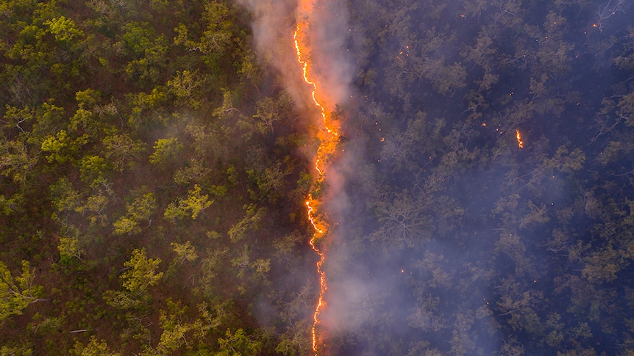
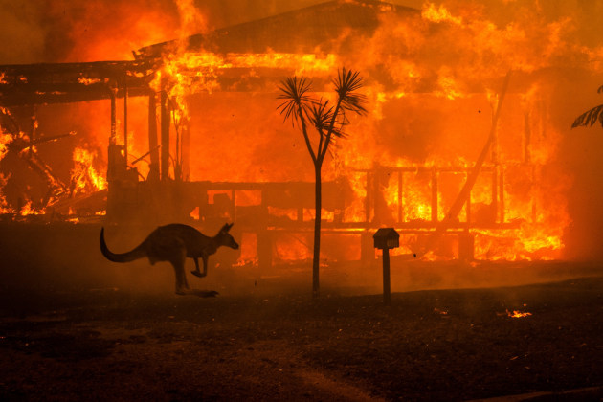
Situation
Notes:
We are all aware about the recent bushfires that occurred across the Australia. The bushfires had a devastating impact to its fire season in 2019 before rain helped contain the fires in February 2020. Australia recorded an average maximum of 41.9C temperature compared to 40.3 in 2013.

Slide 3
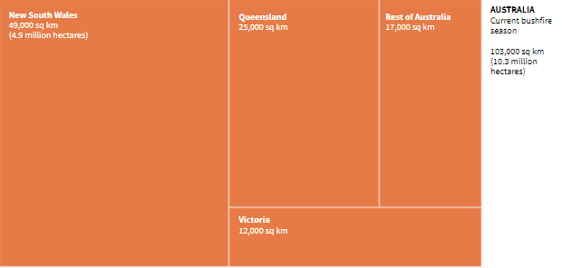
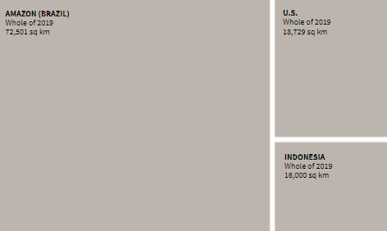
Situation
Notes:
So, how big were the Australian fires?
As we can see, the orange area, that’s 10 million hectares of land which has been razed by bushfires across Australia compared to brazil’s amazon region, US and Indonesia colored in grey.

Slide 4
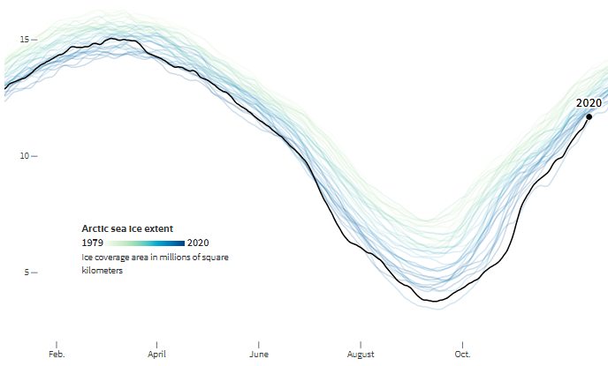
Situation
Notes:
The lines in the graph indicates different years. As we can see, the arctic sea extent reached its annual minimum in September 2020 which is below 5 million square kilometer.
There are other cases of extreme events occurring such as hurricanes, heavy rains & increased temperatures. All of these events occurring at once indicate climate change.

Slide 5
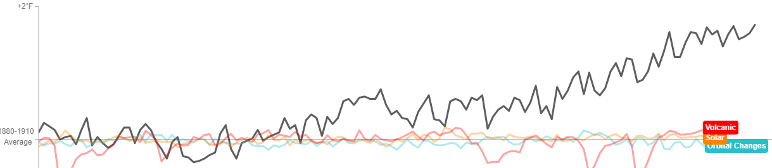
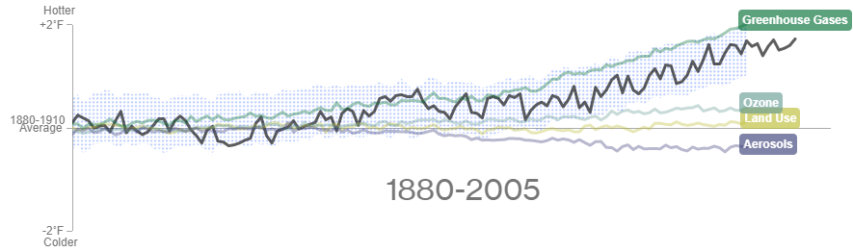
Cause
Notes:
We will look into different factors to understand the causes behind climate change.
The first graph includes natural factors and the second graph includes man-made factors with temperatures from year 1880 to 2005. The black line in both graphs shows measured or observed land-ocean temperature.
The green line shows the influence of greenhouse gases with temperature higher than other factors.
So, greenhouse gases plays a dominant role in warming the world while considering all possible human and man-made factors.

Slide 6
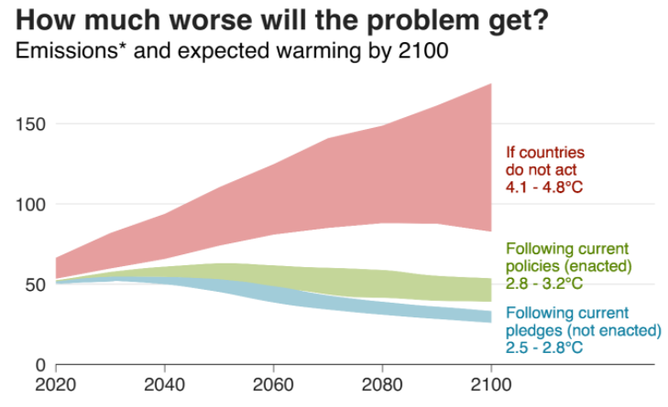
Solution
Notes:
Scientist believe that keeping the global rise temperature below 2C is the safe limit of climate change. If countries do not act, this is how worse the emissions will result in global warming, which is 4.1 – 4.8C by the end of 2100. Following current pledges and policies will have a temperature between 2.5C – 3.2C.

Slide 7

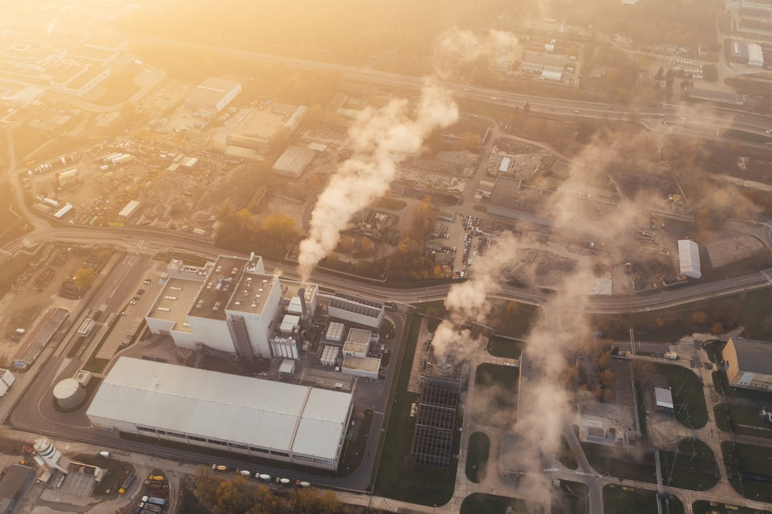
Solution
Notes:
So, What can we do to prevent further climate damage? ……Country governments need to pledge to limit global temperature increase to below 2C above pre-industrial levels. While governments make the bigger changes, individuals can play a role too. We need to use public transport & energy efficient resources like electric cars, reduce foods with high carbon footprint and avoid throwing them. Everyone has a role to reduce environmental impact by changing their lifestyle.
To conclude, many natural and man-made factors responsible for climate change but everyone with each doing something can help to avoid further damages to climate.

Slide 8
References
Images – Robert Irwin, Matthew Abbott & Unspash
Visualization – reuters, bloomberg & bbc
The Verge. 2021. What you need to know about the Australia bushfires. Available at: <https://www.theverge.com/2020/1/3/21048891/australia-wildfires-koalas-climate-change-bushfires-deaths-animals-damage>
BBC News. 2021. What is the Paris climate agreement and why is the US rejoining?. Available at: <https://www.bbc.com/news/science-environment-35073297>
BBC News. 2021. Climate change: Where we are in seven charts and what you can do to help. Available at: <https://www.bbc.com/news/science-environment-46384067>

